Slide 1


Optimization Machine Downtime

Slide 2



Project Leadership
Sharat Manikonda
Director at Innodatatics and Sponsor
linkedin.com/in/sharat-chandra
Bharani Kumar Depuru
CEO & Managing director of 360DigiTMG
linkedin.com/in/bharanikumardepuru
Sai Sanjana Kotha
Student at StFrancis College For Women
linkedin.com/in/saisanjana-kotha

Slide 3
Team Members
Name:
https://www.linkedin.com/profilelink

Slide 4

Contents
Business objective
Business Constraints
Project Architecture
Data collection and details
Exploratory Data Analysis
Visualization
Modeling
Evaluation
Deployment
Notes:
Change

Slide 5
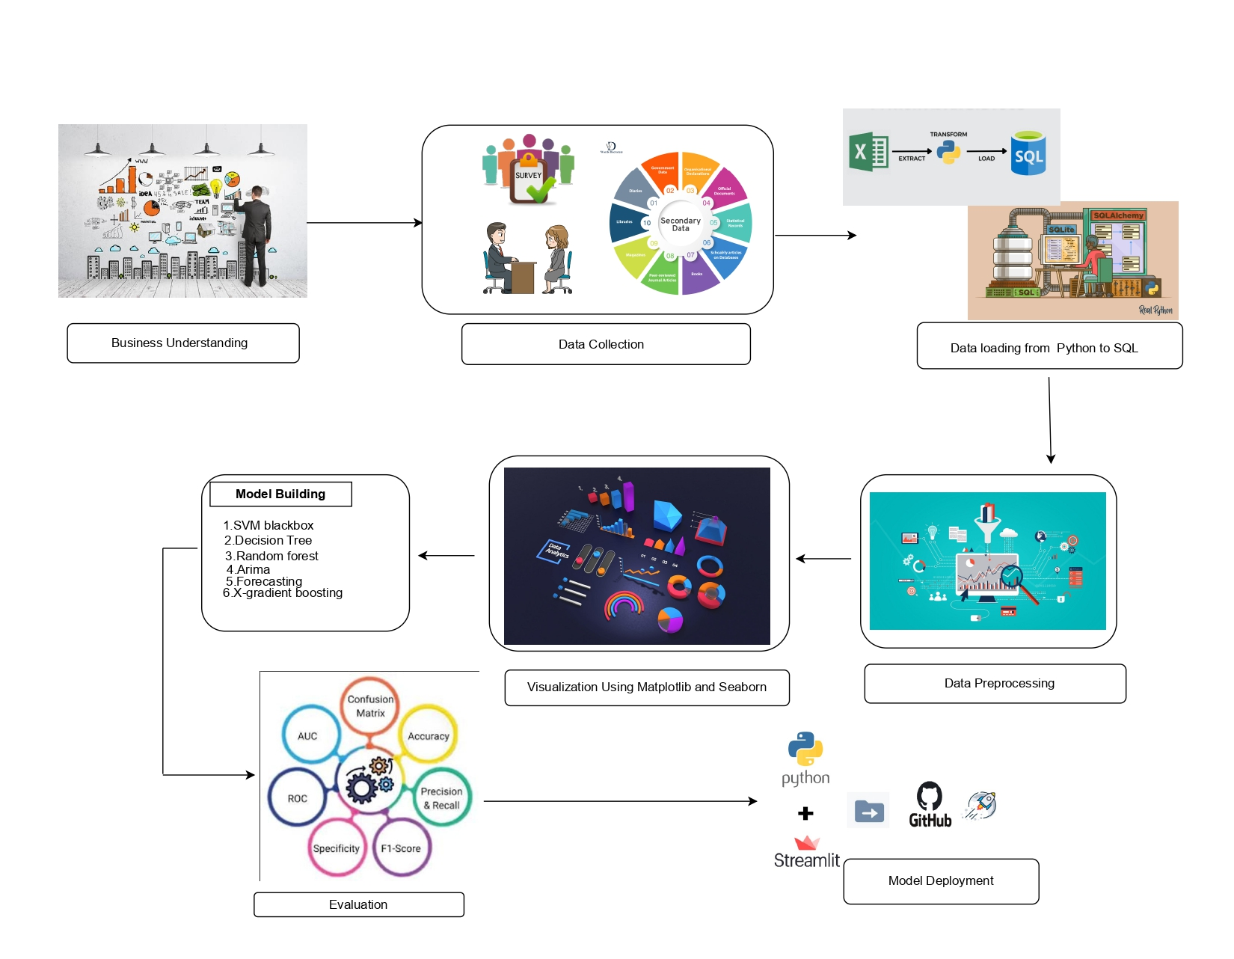
Project Overview and Scope

Slide 6

Business Problem
Unplanned machine downtime of machines which manufacture pumps is leading to loss of productivity.

Slide 7

Business Objective
Objective
Constraints
Minimize unplanned machine downtime.
Minimize maintenance cost.

Slide 8
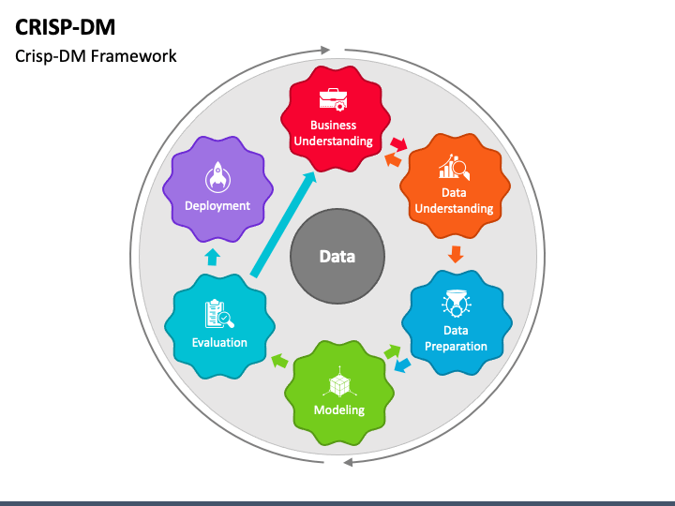
There are six stages of CRISP-ML(Q) Methodology
1. Business and data understanding
2. Data preparation
3. Model building
4. Model evaluation
5. Model deployment
6. Monitoring and maintenance
CRISP-ML(Q) Methodology

Slide 9

Technical Stacks
PANDAS – Library used for data manipulation.
NUMPY – Library used for numerical calculations.
SKLEARN – Library used for machine learning algorithms.
MATPLOTLIB – Library used for visualization.
SEABORN – Library used for advanced data visualization.
PICKLE – Python module used for serializing and deserializing objects.
JOB LIB – Library used for saving and loading Python objects to disk.
STATS MODEL – Library used for statistical calculations.
FEATURE ENGINE – It transforming raw data into meaningful features used by ML model to improve predictive performance.
SWEETVIZ – Library for visualizing and analysing data.
STREAMLIT – Library that enables rapid development of web applications.
POWER BI – Visualization tool.

Slide 10

Data Collection and Understanding
Data Collection : The data set was a real time data given by 360digitmg as per NDA.
Data Understanding: To understand the collected data, the following steps:
The data set consists of a timestamp, machine type, shopfloor, and several operational metrics, & has been collected at a daily level, with a total of 2500 rows and 16 columns.
There are five types of machines in the data set: Makino-L1-Unit1-2013, Makino-L2-Unit1-2015, Makino-L3-Unit1-2015, Shopfloor-L1, and Shopfloor-L2.
The operational metrics include efficiency (OEE), quality (OQ), speed (OS), availability (OA), and maintenance time (MT).There are some missing values in the dataset.
The data set contains a "Machine_Failure" binary column indicating whether there was a machine failure during a specific day.The dataset includes a mix of numerical and categorical data types.

Slide 11
Data Information
The dataset contains 2500 entries and 16 columns. Here is some key information about the columns:
The 'Date', 'Machine_ID', 'Assembly_Line_No', and 'Downtime' columns are of type object.
The numerical columns such as 'Hydraulic_Pressure(bar)', 'Coolant_Pressure(bar)', 'Air_System_Pressure(bar)', 'Coolant_Temperature', 'Hydraulic_Oil_Temperature(°C)', 'Spindle_Bearing_Temperature(°C)', 'Spindle_Vibration(µm)', 'Tool_Vibration(µm)', 'Spindle_Speed(RPM)', 'Voltage(volts)', 'Torque(Nm)', and 'Cutting(kN)' are of type float64.
There are some missing values in several columns, as indicated by the difference in non-null counts across columns.

Slide 12
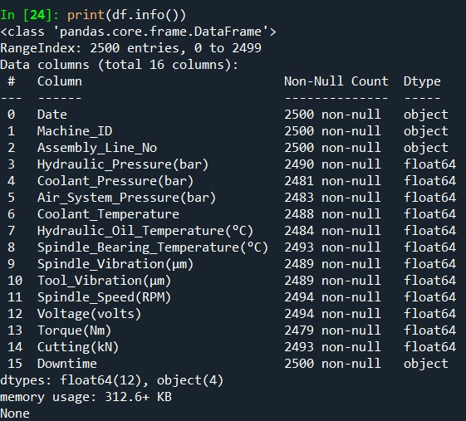
Data Information
The data set contains the data types like float and object.

Slide 13

Data Dictionary
Date : The date and time of the measurement or event.
Machine_ID : The unique identifier of the machine.
Assembly_Line_No : The assembly line number.
Hydraulic_Pressure(bar) : The hydraulic pressure in bars.
Coolant_Pressure(bar) : The coolant pressure in bars.
Air_System_Pressure(bar) : The air system pressure in bars.
Coolant_Temperature : The coolant temperature.
Hydraulic_Oil_Temperature(°C) : The hydraulic oil temperature in degrees Celsius.
Spindle_Bearing_Temperature(°C): The spindle bearing temperature in degrees Celsius.
Spindle_Vibration(µm) : The spindle vibration in micrometers.
Tool_Vibration(µm) : The tool vibration in micrometers.
Spindle_Speed(RPM) : The spindle speed in revolutions per minute.
Voltage(volts) : The voltage.
Torque(Nm) : The torque.
Cutting(kN) : The cutting force.
Downtime : Indicates whether a machine failure occurred or not, with values
'Machine_Failure’ and 'No_Machine_Failure'.

Slide 14
System Requirements
To provide system requirements for the dataset, we can consider factors such as memory usage, processing power, and storage capacity.
Based on the dataset information:
The dataset contains 2500 entries and 16 columns.
The memory usage is approximately 312.6 KB.
For processing this dataset efficiently, a system with the following specifications would be suitable :
Memory: At least 1 GB of RAM to comfortably handle the dataset in memory.
Processor: A modern processor with multiple cores to handle data processing tasks efficiently.
Storage: Sufficient storage space to store the dataset and any additional files or outputs generated during analysis.
These are general recommendations and the actual system requirements may vary based on the specific analysis and processing tasks you plan to perform on the dataset.

Slide 15
Exploratory Data Analysis [EDA]
Importing Necessary Libraries: The code imports various libraries and modules required for data processing, machine learning, and visualization, such as pandas, sklearn, statsmodels, matplotlib, and seaborn.
Loading the Offline Data: The code reads a CSV file named 'Machine Downtime.csv' and stores the data in a `pandas` DataFrame (df) . It then prints the first few rows of the DataFrame, the information about the DataFrame, and the column names.
Exploring the Data: The code checks the value counts of the 'Downtime' column and generates the descriptive statistics (mean, variance, skewness, and kurtosis) for the numerical columns in the DataFrame.
Notes:
EDA is used for seeing what the data can tell us before the modeling task.
Change

Slide 16
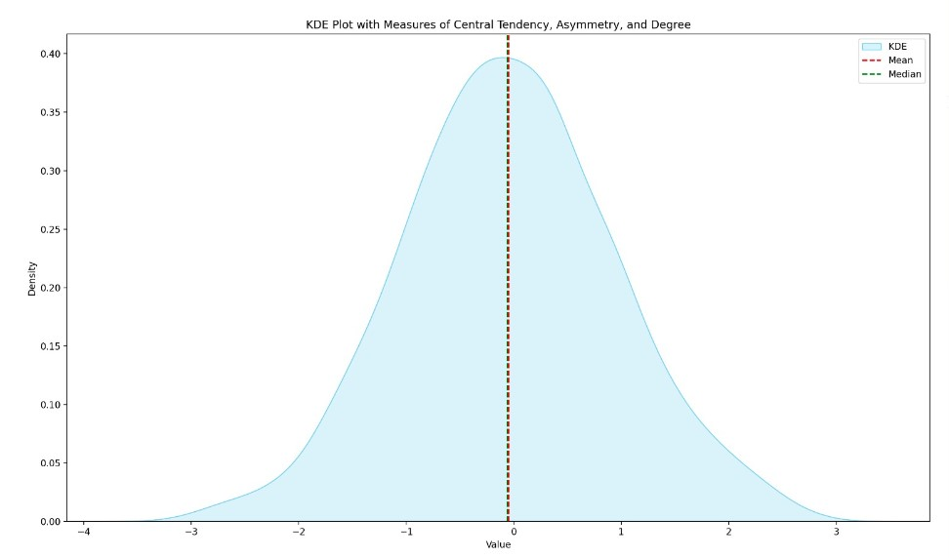
Exploratory Data Analysis [EDA]
X-axis – value
Y-axis – density
legend(blue shaded) - KDE
Dashed lines – Mean & Median
Bell shaped, normally distributed
Symmetric distribution
+ve kurtosis
Notes:
EDA is used for seeing what the data can tell us before the modeling task.
Change

Slide 17
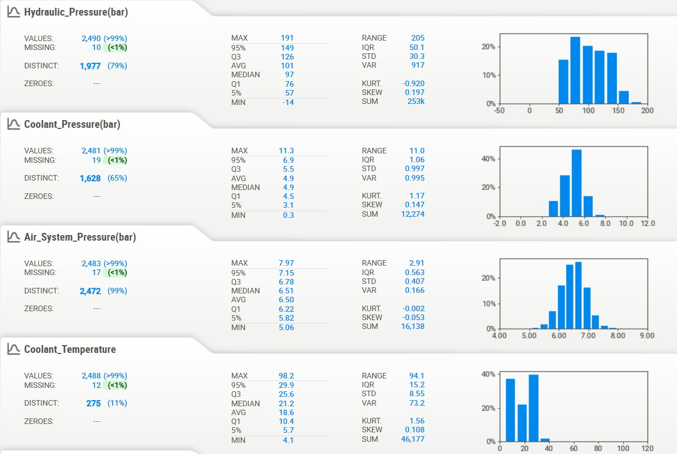
Missing Values Observation
Hydraulic Pressure(bar) : 10 missing values
Coolant Pressure(bar) : 19 missing values
Air System Pressure(bar) : 17 missing values
Coolant Temperature : 12 missing values
Hydraulic Oil Temperature (°C) : 16 missing values
Spindle Bearing Temperature (°C): 7 missing values
Spindle Vibration (µm) : 11 missing values
Tool Vibration (µm) : 11 missing values
Spindle Speed (RPM) : 6 missing values
Voltage (volts) : 6 missing values
Torque (Nm) : 21 missing values
Cutting (kN) : 7 missing values

Slide 18
Data Preprocessing
Handling Missing Values:-
The code identifies that there are missing values
in the dataset and that imputation is required.It uses the ‘SimpleImputer’ from the ‘sklearn.impute’ module to impute the missing values using the mean strategy.The imputation is done as part of a ‘num_pipeline’ that is created using the ‘Pipeline’ class from ‘sklearn.pipeline’.
WINSORIZER:- Method to handle outliers.
Data loading
Duplicates
Handling Missing Values
Scaling
Outlier Treatment
Splitting Data into X,Y
Encoding Target Variable
Notes:
Keep observations

Slide 19
Data Preprocessing
Scaling the Data:-
After imputing the missing values, the code scales the numeric features using the ‘MinMaxScaler’ from the ‘sklearn.preprocessing’ module.
The scaling is also done as part of the ‘num_pipeline’ along with the imputation step.
The code then creates a ‘preprocessor’ using the ‘ColumnTransformer’ from ‘sklearn.compose’. This ‘preprocessor’ applies the ‘num_pipeline’ to the numeric features and an ‘encoding_pipeline’ to the categorical features. The ‘encoding_pipeline’ uses the ‘OneHotEncoder’ from ‘sklearn.preprocessing’ to encode the categorical features.
The final preprocessed data is stored in the ‘X’ DataFrame, which is then used for further analysis and modeling.

Slide 20
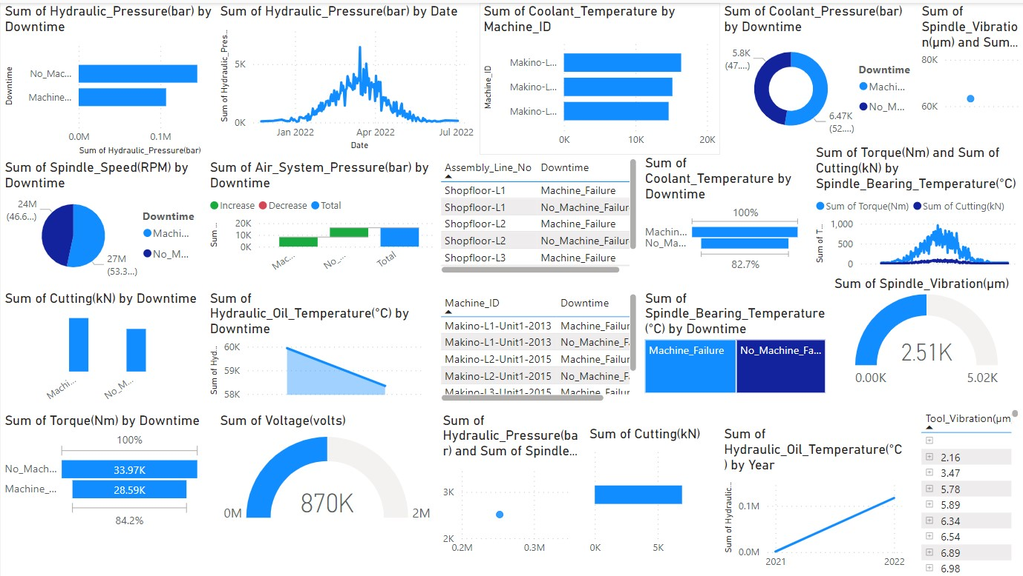
Data Visualization
Notes:
Add graphical

Slide 21
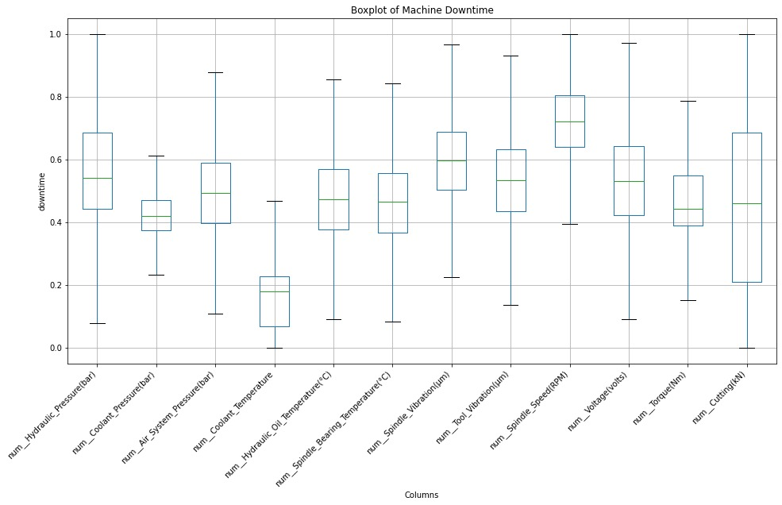
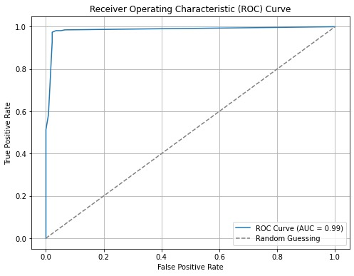

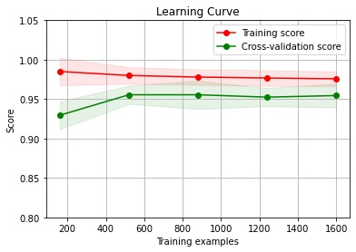
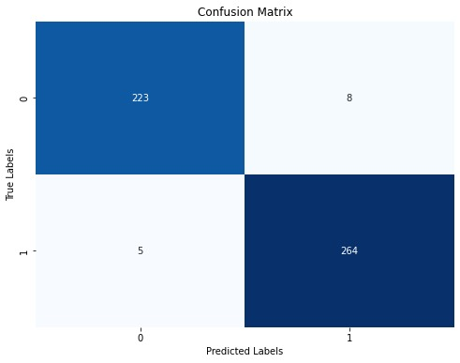
Data Visualization
Notes:
Add graphical

Slide 22
Model Building
By using the preprocessing code we build 5 models
DECISION TREE : Model is trained on training data and performance is evaluated on both training and testing data.
K-NEAREST NEIGHBORS(KNN) : Model is trained on training data and performance is evaluated on both training and testing data.
GRADIENT BOOSTING : Model is trained and evaluated on training and testing data.
LOGISTIC REGRESSION : Training and evaluation is performed.
SUPPORT VECTOR MACHINE(SVM): Model is trained on training data and performance is evaluated on both training and testing data.
NOTE: Hyper parameter tuning using GridSearchCV and performance metrics like precision, recall, roc_auc score, accuracy and f1 score are performed for every model.
Notes:
classification is the task of predicting a discrete class label. Regression is the task of predicting a continuous quantity.
What is classification techniques in machine learning?
The Classification algorithm is a Supervised Learning technique that is used to identify the category of new observations on the basis of training data. In Classification, a program learns from the given dataset or observations and then classifies new observation into several classes or groups.
What is regression techniques in machine learning?
Regression is a technique for investigating the relationship between independent variables or features and a dependent variable or outcome. It's used as a method for predictive modeling in machine learning, in which an algorithm is used to predict continuous outcomes.

Slide 23
Model Accuracy Comparison
S.NO | MODEL NAME | Train accuracy before tuning | Test accuracy before tuning | Train accuracy after tuning | Test accuracy after tuning | F1 value | Precision | ROC_AUC value | Recall | Final accuracy
1 | DECISION TREE | 100% | 96.80% | 97.80% | 97.40% | 97.40% | 97.40% | 98.51% | 97.40% | 97%
2 | KNN | 93.50% | 88.20% | 100% | 93.20% | 93.61% | 94.68% | 98.87% | 92.57% | 93%
3 | GRADIENT BOOSTING | 100% | 99.20% | 97.75% | 98.40% | 98.52% | 98.15% | 99.50% | 98.88% | 98%
4 | LOGISTIC REGRESSION | 86.10% | 84.20% | 86.10% | 84.20% | 85.18% | 85.98% | 91.54% | 84.39% | 84%
5 | SVM | 87.10% | 83.80% | 86.60% | 83.60% | 84.59% | 85.55% | 91.37% | 83.64% | 84%

Slide 24
Best Model
DECISION TREE :
Decision tree helps in interpretability and are easy to understand.
They capture non-linear relationships between features and target variable.
They can handle missing values in the data without requiring imputation or preprocessing.
Decision trees are robust to outliers in data.
They are scalable and versatile, handling larger data sets, and both regression and classification tasks.
Decision trees are fundamental building blocks for ensemble methods such as random forest,gradient boosting and adaboost.
Decision trees helps in controlling overfit.
NOTE: As the train and test accuracy score after tuning, f1 score, precision, roc_auc score, recall, final accuracy for decision tree is high so we consider it as best model.
Notes:
Why Random Forest Regression is good?
A Random Forest Regression model is powerful and accurate. It usually performs great on many problems, including features with non-linear relationships
How is XGBoost different from random forest?
One of the most important differences between XG Boost and Random forest is that the XGBoost always gives more importance to functional space when reducing the cost of a model while Random Forest tries to give more preferences to hyperparameters to optimize the model..
n_estimators — the number of decision trees you will be running in the model

Slide 25
Model Deployment - Strategy
LOAD MODEL AND COMPONENTS : we use pre-trained decision tree model and two pre- processing components(imputer & winsorizer) using the ‘joblib’ library.
DEFINE THE PREDICTION FUNCTION: A function ‘predict_downtime’ which takes Dataset as input preprocesses it and then use trained model to make predictions which formatted as a dataframe.
CREATE A STREAMLIT APP : It contains file uploader to upload csv or excel file containing the data to be predicted.
PREDICT AND DISPLAY THE RESULTS: Upon clicking the predict button in streamlit app
upload file and then it shows the results.

Slide 26
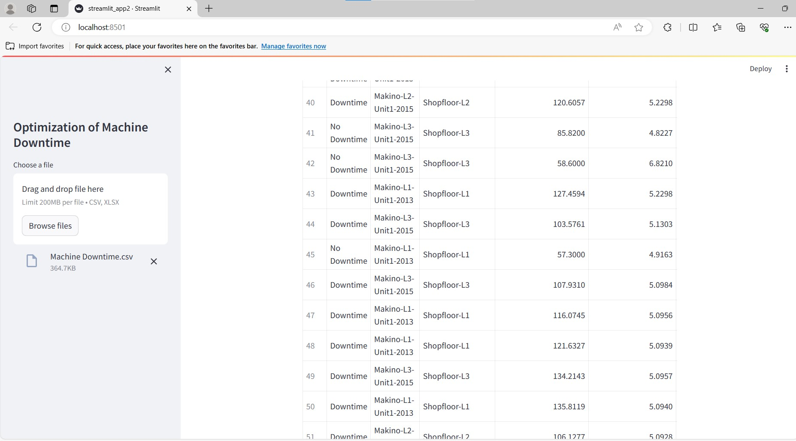
Screen shot of output

Slide 27
Challenges
COMPLEX DATA TYPES : The dataset contains a mix of numerical and categorical data which may require different preprocessing strategies. machine ids and assembly no are categorical need encoding while pressure and temperature are numerical need scaling.
MISSING/INCONSISTENT DATA : because of many technical measurements there are missing values which affect the accuracy of predicted models.

Slide 28
Future Scopes
The dataset, which include detailed machine performance metrics and downtime incidents, offers potential for predictive maintenance and optimization of manufacturing processes. By analyzing trends and correlations in the data, it could be used to enhance machine uptime,reduce costs,and improve overall operational efficiency.

Slide 29

Queries ?

Slide 30


